Slide 1
Chapter 8: Storyboard
The project's working document
The project's report
The project's tool for communication with stakeholders

Slide 2
Project title:
Date:
Version:
Previous version:

Slide 3
Identify
Background for this project:
Related projects:
Notes:
Use this slide when appropriate or required by project owner and/or steering committee.
Include a description of the project background (why it was chosen).
Optional: Specify any relationships with other projects that run in parallel or to be started later (Program of projects).
Optional: Use the matrix to calculate the project score against the criteria that the business has defined for prioritization and selection of projects. Description of the Priority matrix is ​​found in the chapter describing the Improve phase.

Slide 4
The next 4 slides contain basic project management tools to be consecutively updated throughout the project. Initially during DEFINE:
Activity list
Communication plan
Progress plan
Risk factors
D
MA
I
C

Slide 5
Project's activity list
Activity description | Deadline | Responsible | Participants | Status
D
MA
I
C
Notes:
The above activity list is used if the project team deems it appropriate. Activity management can also be conducted “outside” the storyboard.
The activity list format should be adapted to project needs.
It is good working practice that all project meetings begin with a review of the situation in relation to agreed activities.
It is also good working practice to update the activity list before project meetings are concluded.

Slide 6
Communication plan
Communication to ensure progress
Who (stakeholder) | Why communicate with stakeholder? | What do we want to communicate/ achieve? | How do we get our message across? | Who is responsible? | When? | Status
The communication plan shall be reviewed and updated for every project meeting
Version 1: Shows assumed communication needs
Version 2 ->N: Shows agreed communication activities and status
D
MA
I
C
Notes:
The communication plan is compulsory.
The first version of the communication plan should be created in Define. Thereafter it should be updated continuously.
When the project identifies new stakeholders should these if possible be contacted and further communication agreed.

Slide 7
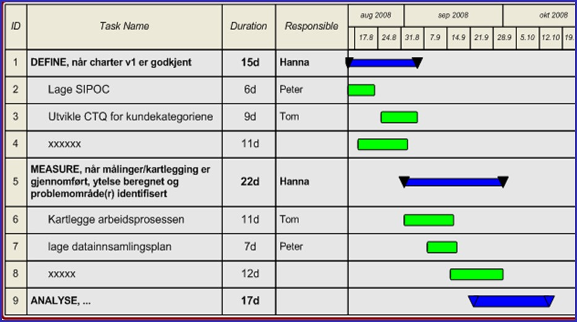
Project schedule – Gantt chart
Project schedule and status
  Meeting schedule
Date & time | Date& time | Date & time | Date & time | Date & time | Date & time | Date & time
D
MA
I
C
Notes:
A project schedule visualizing milestones and activities is compulsory.
The first version of the schedule is made in Define.
Thereafter it should be updated continuously.

Slide 8
Risk factors
Which important factors can impact the project’s progress and success
Probability of successful execution:
Date
Probability (%)
Risk factors | Criticality | What should be done (actions)
Criticality scale: 1-5, 5 is most severe.
D
MA
I
C
Notes:
Top table:
The table is an optional tool. It is used if required by the project owner or steering committee.
Project manager and team rate the likelihood of project success. The assessment should be done weekly. Brainwriting is recommended for the team assessment. The table gives the opportunity to monitor the risk as a function of time (trend).
Bottom table:
The table visualizes the conclusion of a project risk assessment.
Risk assessment for project success is mandatory.
Risk analysis is done the first time in Define. Then updated continuously.
Enter the factors that can significantly influence project success.
Highlight the factors that the project needs help to manage/remove.

Slide 9
Here, the DMAIC-method starts
... from problem statement to sustained improvements
DMAIC
D
MA
I
C

Slide 10
DEFINE
Roles (project manager, supervisor, project owner, project team)
Project title
Problem statement
High level process map
Customers and other stakeholders
Customer and stakeholder requirements
Business Case and other gains
Progress plan
Risk factors
D
MA
I
C

Slide 11
Project organization
Project owner:
Project manager:
Project participants:
Project supervisor:
Steering committee (if applicable):
Other important stakeholders:

Slide 12
What is the problem?
Problem statement:
Process scope (start, stop) – from SIPOC on next slide:
Project scope (include, exclude):
D
MA
I
C
Notes:
Tips to the problem statement:
Describe the problem from a business and/or customer perspective.
The statement should be solution neutral.
Describe adverse consequences of the problem.
When possible: include facts that explain the extent/importance.
When possible: include known examples illustrating the problem.
Avoid «offensive» descriptions.

Slide 13
In which process are important causes found?
Who are the customers and other stakeholders with requirements?
Supplier | Input | Process | Output | Customer
 |  | Process name
Step 1
Step 5
Step 6
Step 4
Step 3
Step 2
Step 7
D
MA
I
C
Notes:
If important root causes are found in more than one process: prioritize one of them. The alternative is to start two or more sub-projects, each addressing one process.
Customers may be internal customers, external customers, process owner, process customers, authorities, employees and other stakeholders.
Suppliers may include internal suppliers, external suppliers, authorities.
Each input must have one or more suppliers.
Each output must have one or more clients.
The process steps may preferably be specified as verbs.
Enter only the main process steps. If there are many steps in the process: consider merging steps (this often simplifies communication). It need not be so that all process steps are carried out each time. It need not to be so that the process steps are always carried out in the order specified.
There need not be a horizontal relationship between supplier and input. The suppliers and inputs can therefore be listed in an arbitrary order. The same applies to output and customers.
Remember to visualize priorities in the SIPOC. Reasons for the prioritizations should be stated.
Examples of inputs/outputs are:
Physical products
Services
Information
Measurements
Report
Analyzes
Checklists
Work orders, batch forms
Competence
Decisions
Resources
Procedure/methods/standards
Frameworks, constraints, agreements and legislation
Environmental and safety requirements, hygiene requirements, fire regulations

Slide 14
What are the customer and stakeholder requirements?
(The CTQ tree, specifies the problem statement in terms of performance metrics)
Satisfied when ...
Drivers/
categories
Metric
Requirement
Prioritized metrics from the CTQ tree above:
Metric | Baseline | Project goal | Ideal performance
D
MA
I
C
Notes:
How to use the CTQ tree and the summary table:
The CTQ tree shall specify/detail the customer requirements. The tree top reads “the customer is satisfied when..”. The CTQ tree makes this statement concrete. The right part of the tree identifies the variables driving the customer satisfaction along with the improvement requirements.
The CTQ tree is NOT a fault tree. That requirement tree should not visualize the causes of the problem.
Each customer or customer category should have its own tree. A single, common CTQ tree can optionally be made after collecting the requirements of all customers.
There may be more than three levels in the CTQ tree.
The CTQ tree mandatory if the variables to be improved are known from the project start.
Alternative categories may be: quality, progress, economics, HESS, product, process.
Prioritized variables should be highlighted in the CTQ tree and copied into the summary table.
The table identifying the prioritized variables is copied into the project charter.
In many cases, baseline performance for the prioritized CTQ variables is unknown. The corresponding requirements may also be known in the Define phase. In such cases the project team, the Black Belt and the project owner should consider whether the baseline performance should be measured and whether the requirements can be defined at a later time when the potential for improvement is identified.

Slide 15
Other project scope requirements to ensure sustain and future opportunities (only used if relevant)
What should be included in the project scope to ensure “sustain” (option)
What should be included in the project scope to ensure future opportunities/reuse (option)
D
MA
I
C
Notes:
Scope requirements to ensure sustain - used this if it is relevant.
This includes expected mechanisms/structures needed to ensure sustained improvements. Detailing and development of these mechanisms are included in the project scope. Examples of mechanisms include specification of new responsibilities, changes of process documentation, changes in the relevant systems and changes in training programs. The mechanisms should at this stage only be identified. See Control phase of DMAIC which typical mechanisms that are required to ensure sustain.
Scope requirements to ensure reuse - used this if it is relevant.
This requirements on the project to ensure and/or prepare for reuse of the project results. Reuse is for example desirable in other projects, in other processes, for other products, for other customers for other services and in other business units. Such requirements may for example imply that solutions must be standardized at a higher level and documented in a more comprehensive manner.

Slide 16
Initial estimate of economical gains (business base) and other gains
Income/savings | USD
Sum
Costs
Sum costs
Gain
Other gains
Other formats for calculating economical gains may be required.
D
MA
I
C
Notes:
Discuss financial gains with an economy functioning in the business.
Business case (BC) may be described as a combination of text and numbers.
When it is difficult to calculate the economic benefits use qualified estimates. This may be appropriate for example when assessing increased sales or reduced business risk.
Consider distinction between one-time gains and recurring gains.
Consider including potential profits from scaling the solutions (for example by reusing solutions).
The BC should be revised regularly. The BC is normally an important decision criteria when selecting solutions in the Improve phase.
Assess the benefits in year 1, year 2, ...
Types of economic gains:
reduced costs
direct costs
If the project is successful, the business results will improve with the specified amount
“Indirect” costs
When the solutions are implemented, there are still decisions to be made to fulfill the BC ambition. E.g.: Improving resource efficiency in a process will lead to economical gains when the resource is reinvested in other value-adding activities.
Increased revenues
Deferred investment
Reduced capital employed
Improved cash flow
Include "soft" benefits:
Reduced risk of injury
Increased customer/employee satisfaction
Reduced absenteeism
Less "firefighting" and stress
Improved employee involvement
Improved sense of achievement
Strengthened ownership and sense of being important

Slide 17
Project schedule (plan)
Milestone
Activity
Meeting schedule:
Date: time: | Date: , time: | Date: , time: | Date: , time: | Date: , time:
D
MA
I
C
Notes:
Create a project schedule (plan) with milestones and underlying activities. This is mandatory.
If the project do not have a project management tool available, a table can be used.
The project’s meeting plan should be agreed upon and included in the storyboard.

Slide 18
Risk factors and mitigating activities
Risk factors | Criticality | What should be done (actions)
Criticality scale: 1-5, 5 is most severe.
D
MA
I
C
Notes:
The table visualizes the conclusion of a project risk assessment.
Risk assessment for project success is mandatory.
Risk analysis is done the first time in Define. Then updated continuously.
Enter the factors that can significantly influence project success.
Highlight the factors that the project needs help to manage/remove.

Slide 19
MEASURE & ANALYZE
Root causes of inadequate performance of the CTQs
D
MA
I
C

Slide 20
Direct causes of inadequate performance
Category 1
Category 2
D
MA
I
C
Notes:
Create a fishbone diagram for each CTQ to be improved.
The diagram above is limited to direct causes.
Mark the prioritized direct causes.
Examples of directly causes:
Errors in the drawings
The machine stops
Inadequate orders
Wrong material
Imprecise measuring instruments
For long batches
For a long changeover time
Wrong tool used
For late start of work
To long throughput time
Counting error/miscalculation/entry errors

Slide 21
Arguments for selection of direct causes one table for each CTQ
Effect | Selected direct cause | On what basis was the selection made?
Metric (CTQ)
D
MA
I
C
Notes:
Create a table for each CTQ to be improved.
Specify the prioritized direct causes of inadequate performance for each CTQ (the same direct causes as visualized in fishbone diagram).
Specify how the team has verified / chosen the direct causes.
Measurements, analyzes and process maps supporting the conclusion in the table should be documented and included by inserting new pages after this slide.

Slide 22
Use bullets to visualize causal relationships one slide per CTQ
Category 1
Direct cause 2
  Underlying cause
    Underlying cause
      root cause
      root cause
  Underlying cause
    Underlying cause
      root cause
Direct cause 3
  Underlying cause
    Underlying cause
      root cause
    root cause
Category 4
Direct cause 6
  Underlying cause
    root cause
    root cause
  Underlying cause
    Underlying cause
      root cause
      root cause
D
MA
I
C
Notes:
The head of the fishbone diagram (the CTQ) should be specified below the title bar.
The categories shall be the same as those found in the previous fishbone diagram.
Direct causes shall be the same as used in the previous fishbone diagram.
Underlying causes and root causes are developed asking 5 Whys.
Highlight the prioritized root causes using colors and/or boxes.

Slide 23
Arguments for selection of root causes one table for each CTQ
Effect | Selected root cause | On what basis was the selection made?
Metric (CTQ)
D
MA
I
C
Notes:
Create a table for each CTQ to be improved.
Specify the prioritized root causes of inadequate performance for each CTQ (the same direct causes as visualized using bullets (previous page).
Specify how the team has verified / chosen the root causes.
Measurements, analyzes and process maps supporting the conclusion in the table should be documented and included by inserting new pages after this slide.

Slide 24
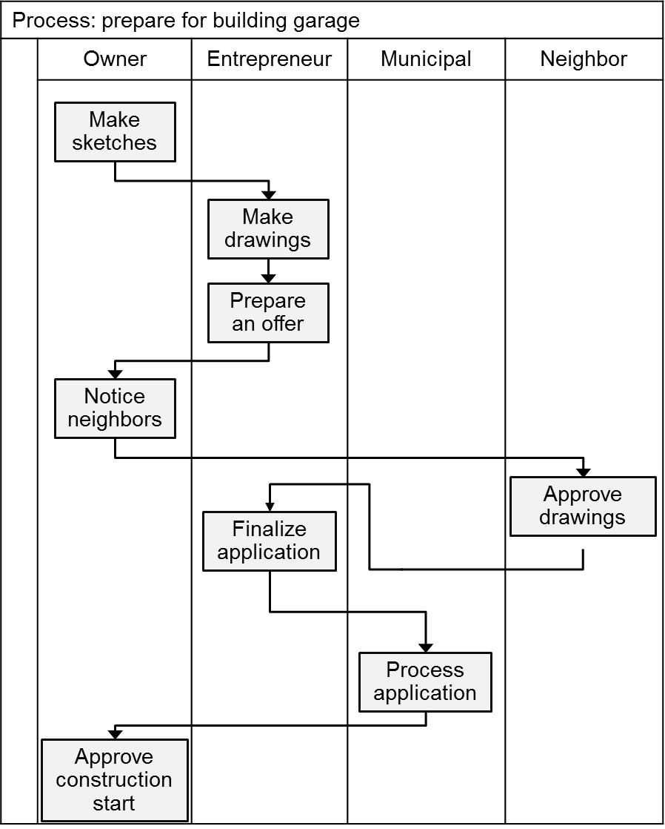
Process maps supporting the selection of direct causes and root causes
Order received
Register
order
Check inventory
Parts available?
NO
Order parts
YES
Send order confirmation
Order closed
D
MA
I
C
Notes:
Include process maps to support selection of direct causes and root causes.
Add boxes, arrows and comments to support your selections.

Slide 25
Data collection plan
What is to be measured (metric):
What is the purpose of measurement?
Measurement unit:
Additional information (attribute information) to be registered and linked to the measurements:
Frequency/duration/number of measurement points:
Responsibility:
Measuring equipment:
Training required? If “yes”, how?
Verification of measurement system required? If “yes”, how?
D
MA
I
C
Notes:
If the team chooses to substantiate assumptions about causal relationships with measurements and analysis, a data collection plan is needed. The plan should be approved by the project supervisor (black belt) and possibly also the project owner before the measurement starts.
The slide above gives suggestions as to what should be included in the data collection plan.

Slide 26
Data analysis supporting the selection of direct causes and root causes
Histogram
Pareto
Control chart
D
MA
I
C
Notes:
Include visualization of measured data to support the selection of direct causes and root causes.
Please add boxes, arrows and comments to elaborate selection.

Slide 27
IMPROVE
Alternative and recommended solutions for each cause
Which criteria formed the basis for the recommendation
Risk analysis for the solutions
Results of any pilot solutions
Update of expected improvements
Update of expected economic gain (business case)
Update of progress plan
Risk factors for project success
Implementation of the solutions (after formal decision)
D
MA
I
C

Slide 28
High level perspective of alternative solutions
Root cause | Solution/measure | Investment required | Implementation time
 | Alt 1:
 | Alt 2:
 | Alt 1:
 | Alt 2:
 | Alt 3:
 | Alt 1:
 | Alt 2:
 | Alt 3:
 | Alt 1:
 | Alt 2:
 | Alt 3:
D
MA
I
C
Notes:
Explanation:
Column 1: Specify the selected root causes to be removed/reduced.
Column 2: If possible, at least two alternative solutions should be specified for each root cause.
column 3: Assess investment needed for each solution.
Column 4: Assess implementation time for each solution.
Expand the table with other project-specific criteria where appropriate. For example, risk of unsuccessful implementation of solution (see later page).
If appropriate, include descriptions of the solutions by inserting new pages after this slide. The descriptions may for example include specifications of new responsibilities, description of the new procedures/processes, descriptions of new equipment, new software, etc.).

Slide 29
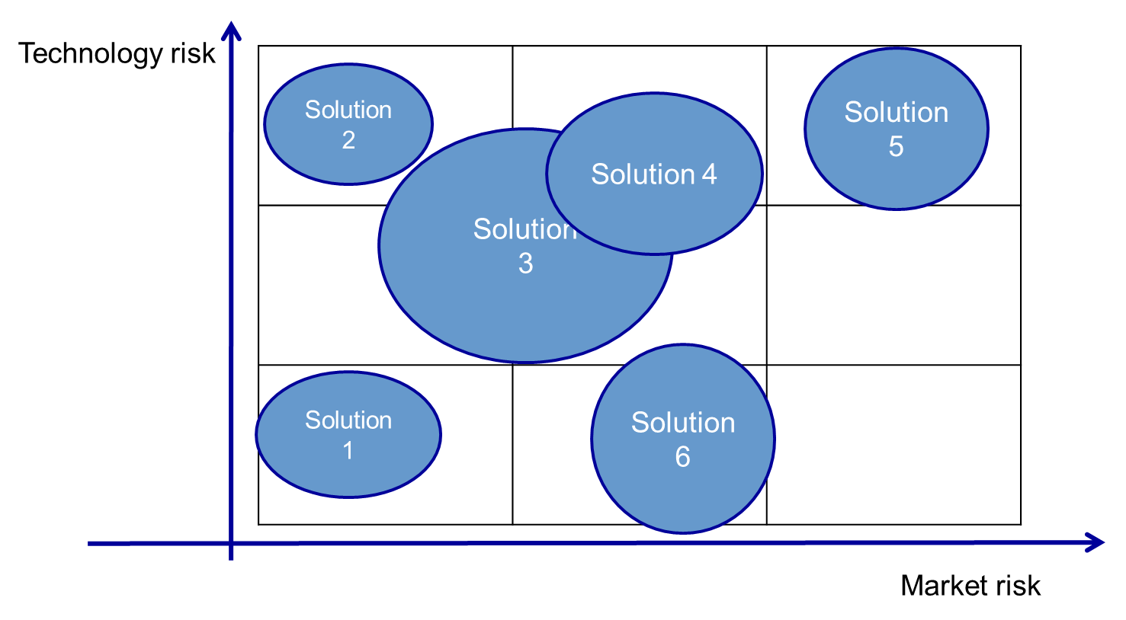
Risk analysis for proposed solutions
FMEA alternative
2D matrix alternative
stage/part | Potential fault | Potential consequence | SEV | Potential causes | OCC | Control mechanisms | DET | RPN
probability | 5
 | 4
 | 3
 | 2
 | 1
 |  | 1 | 2 | 3 | 4 | 5
 |  | Consequence
D
MA
I
C
Notes:
Use FMEA or two-dimensional visual tools to analyze risk for the suggested solutions.
The risk analysis shall include measures to prevent incidents.
The risk analysis should be repeated after the measures have been implemented (next page).

Slide 30
Actions and their effect on risk
Part/stage | Action | Responsibility | Status | Old RPN | New SEV | New OCC | New DET | New RPN
If there are no risks associated with the solutions, the team should specify that risk is assessed, but no risks were identified.
D
MA
I
C
Notes:
If potentially severe incidents have been identified the risk analysis should be repeated after implementation of risk reduction measures.

Slide 31
Selecting solutions (among the alternatives)
- optional tool
Criteria for selection
Weighting factors
Solution alternatives |  |  |  |  | SUM
Alternative
solutions
The team’s rating per cell
D
MA
I
C
Notes:
How to use the Priority matrix:
Specify the alternatives in the first column.
Specify the criteria to be used for selection in the top row. Remember to set the polarity of the criterion. Example: high cost, high customer impact, short implementation time.
Specify the weighting criteria in the second row. The higher the number, the higher significance (consider using criteria matrix to set the weighting factors).
Insert the team voting in the white cells. Each participants enter their score (1, 5, 9). Low value "1" means that the alternative meets the criterion to a small extent. High value "9" means the alternative meets the criterion to large extent. Voting results are summed for each cell and for each row.

Slide 32
Detailing selected solutions
- optional tools
S1
Sub system1
Sub system2
Sub system3
Part1.2
Part1.1
Part2.1
Comp 3.1.2
Part3.1
Comp 3.1.1
Use e.g.
Tree structure
Detailed process maps
D
MA
I
C
Notes:
If appropriate include more detailed descriptions of the solutions in the storyboard. The descriptions can be specifications, process maps, tree structures, drawings, photos, and more…

Slide 33
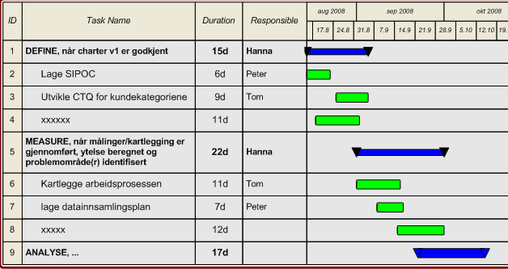
Update project progress plan
D
MA
I
C
Notes:
The solutions are selected, and the details described. Use the insights to update the project schedule.
If implementation is extensive, costly and/or risky: Consider carrying out the implementation as a separate project.

Slide 34
Expected improvements
Metric (CTQ) | Baseline | Original target | Expected performance
D
MA
I
C
Notes:
The solutions are selected, and the details described. Use the insights to update expected improvements for the CTQs.

Slide 35
Expected gains
(include cost – now more detailed and credible)
Income/savings | Initial estimate | Expected
Sum
Costs
Sum costs
Gain
D
MA
I
C
Notes:
The solutions are selected, and the details described. Use the insights to update expected gains.

Slide 36

CONTROL
Documentation of improvements achieved
Documentation of economical gains achieved
Updated measurement systems
Standardized solutions
Updated systems (e.g., QMS)
Provided training
Assignment of new responsibility
Solutions handed over to the line organization
Documented and communicated opportunities for reuse
Documented and communicated new improvement opportunities
Evaluation of the project
D
MA
I
C

Slide 37
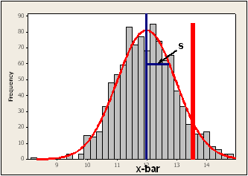
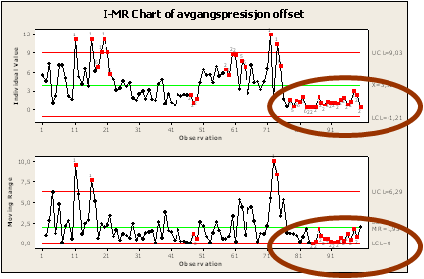
Improvements achieved
Metric (CTQ) | Baseline | Project target | Performance achieved
Illustrate performance improvements with graphics (before/after)
D
MA
I
C
Notes:
Document improvements achieved for each CTQ.
Use tools to visualize performance before and after improvement effort.

Slide 38
Economic gains (USD) generated
Income/savings | Initially estimated | Achieved
Sum
Costs
Sum costs
Gain
D
MA
I
C
Notes:
Document economical gains (if possible).

Slide 39
Specification of necessary changes in measurement system and reports Deliverables in the sustain category
<Specify here>
D
MA
I
C
Notes:
Changes in processes and / or products may result in corresponding changes in measurement systems and reports.
Document which changes are made or are planned. Scheduled activities to be done after completion of the project must be described in the list of remaining activities for handover to the line organization (see later slide).

Slide 40
Remaining list of activities for handover to the process, product and system owners (Deliverable in the sustain category)
Activity | Due date | Responsible | Transferred (date)
D
MA
I
C
Notes:
Column 1: Clear definition of activity.
Column 2: Final date of completion.
Column 3: Responsible leader in the line organization.
Column 4: Date of transfer of activity to the line organization. Leader who takes over the activity must acknowledge that the activity is understood and that it will be implemented.

Slide 41
Deliverables in the sustain category, checklist i.e.: how to ensure duration
NA = not applicable
Description | Yes/No/NA | Responsibility
Have changes in responsibility been formalized and communicated? This includes changes in leaders standard work with close follow-up initially
Has the measurement system for process control been established/updated?
Have existing reports that are impacted by the changes been updated?
Have the solutions been documented?
Are new routines, instructions and standards developed and implemented?
Are relevant systems updated with necessary changes?
Have remaining activities been transferred to the line organization?
Has training been provided?
Have training systems been updated?
If “no”, state why
D
MA
I
C
Notes:
The above table lists typical activities required for sustained improved performance. The project manager, team and project supervisor should discuss and extend the table if necessary.

Slide 42
Project evaluation
Deliverable in the category for future opportunities
Suggested topics to consider:
Project mobilizing and start-up
Communication with project's stakeholders
Methods, tools, templates
Training of project participants (L6S methods and tools)
Project supervising
Project resources (availability and presence of participants) and access to key individuals
Handover of solutions from project to line organization
How the company handles opportunities for reuse of project results
Project owner’s commitment, involvement, support and follow-up
Handling of project risk factors by project owner (and steering committee)
Project's progress, quality of work, economy and result
Others?
D
MA
I
C
Notes:
A good project evaluation will help improve the implementation of later L6S projects.
The evaluation must therefore involve all important stakeholders.

Slide 43
Opportunities for reuse of solutions/knowledge
Deliverable in the category for future opportunities
<Specify here>
D
MA
I
C
Notes:
Improvement projects will often develop solutions and acquire knowledge which can be reused.
Opportunities for reuse should be described her and handed over to the appropriate stakeholder / responsible.
Project owner, L6S program director/Lean manager may be consulted regarding the above.

Slide 44
Proposal for future (new) improvements
Deliverables in the category for future opportunities
<Specify here>
D
MA
I
C
Notes:
Improvement projects will normally detect improvement opportunities which are out of scope. These opportunities should be described here and handed over to appropriate stakeholder/responsible.
Improvement projects will often make priorities and delimitations for best possible return on investment. Some of these priorities and delimitations lead to opportunities for further improvements. These opportunities should be described here and handed over to appropriate stakeholder/responsible.

